Slide 1
Representing sequences graphically
Sequences

Slide 2
how to use Oak lessons

Slide 3
I can represent arithmetic sequences graphically and appreciate the common structure.

Slide 4
An arithmetic (or linear) sequence is a sequence where the difference between successive terms is a constant.
Example: 6, 11, 16, 21, … has a constant difference of +5 therefore it is arithmetic (linear).
Non-example: 1, 2, 4, 8, … does not have a constant difference therefore it is not arithmetic, it is non-linear.

Slide 5

Representing sequences graphically
Plotting arithmetic sequences
Features of sequences represented graphically

Slide 6

Plotting arithmetic sequences
Multiple representations in mathematics can help us to solve problems, understand the structure of some mathematics or expose connections to other areas.
Term number (n) | 1 | 2 | 3 | 4 | 5
Term value (T) | 2 | 4 | 6 | 8 | 10
One representation of an arithmetic sequence such as could be to turn the term numbers and values into coordinates and plot them on a graph.

Slide 7
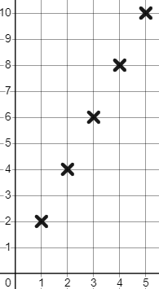
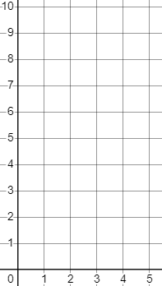
Plotting arithmetic sequences
Term number (n) | 1 | 2 | 3 | 4 | 5
Term value (T) | 2 | 4 | 6 | 8 | 10
Term value
Plot in the form
(Term number, Term value)
(1, 2)
Notice that the points align.
(2, 4)
Arithmetic sequences are also known as linear sequences. They increase or decrease in a straight line.
(3, 6)
(4, 8)
(5, 10)
Term number

Slide 8

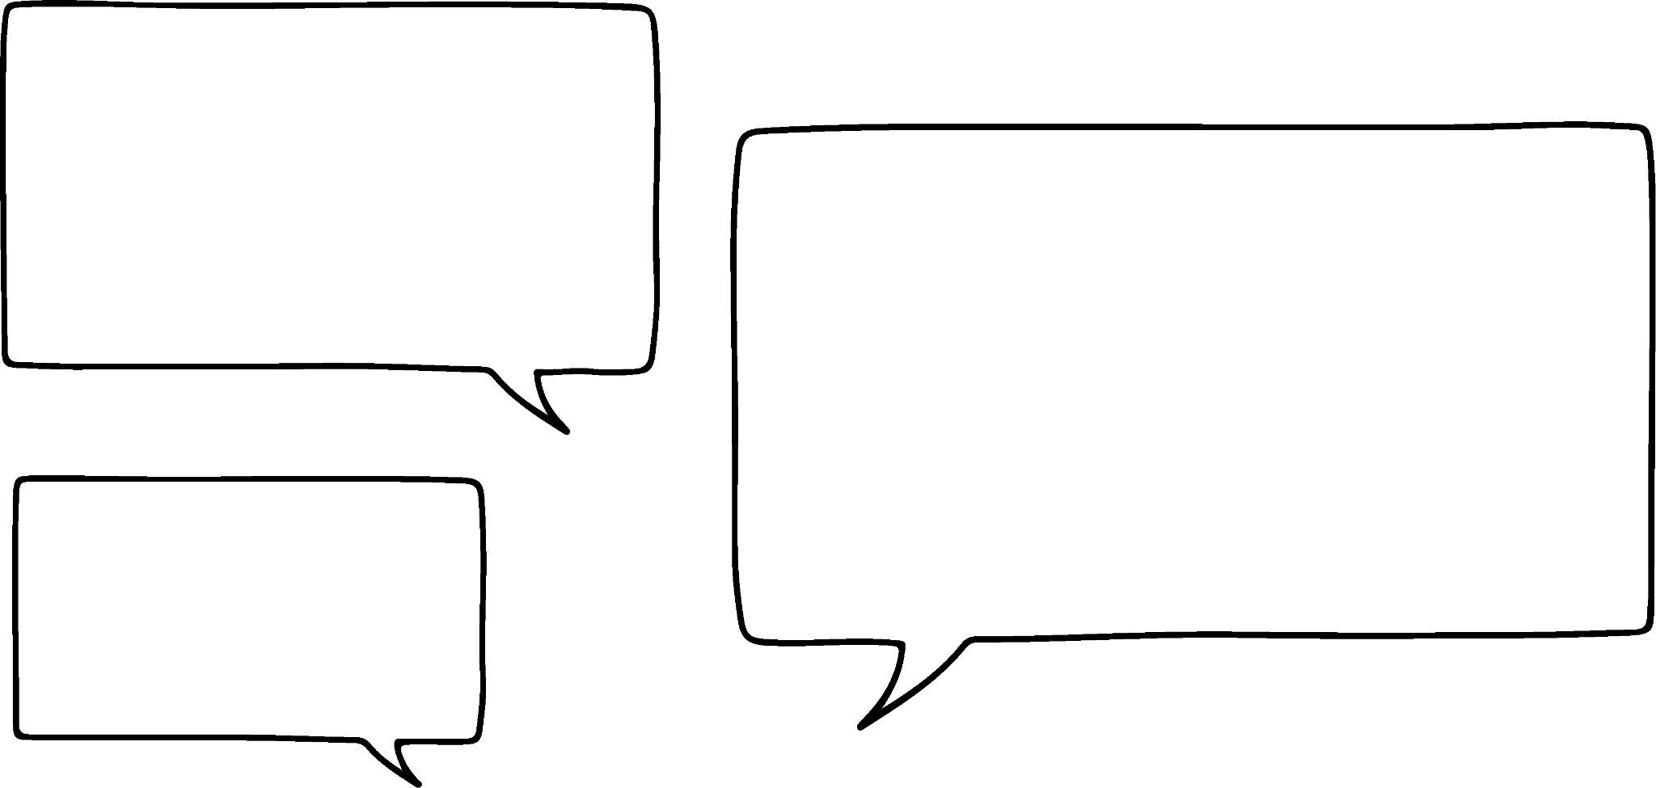
Plotting arithmetic sequences
Term number (n) | 1 | 2 | 3 | 4 | 5
Term value (T) | 2 | 4 | 6 | 8 | 10
Term value
Andeep spots this linear pattern, draws a line, and says:
The 1.5th term is 3
What is wrong with his statement?
We do not draw a line when plotting sequences.
3 is not a term in the sequence 2n.
There is no 1.5th term. Term numbers have to be whole numbers.
Term number

Slide 9
Plotting arithmetic sequences
+1
+1
+1
+1
Term number (n) | 1 | 2 | 3 | 4 | 5
Term value (T) | 2 | 4 | 6 | 8 | 10
+2
Term value
+2
+2
+2
+2
+2
What do you notice about the sequence numerically, and the sequence graphically?
+2
+2
E.g. As the term number increases by 1, the term value increases by 2.
+1
Term number

Slide 10
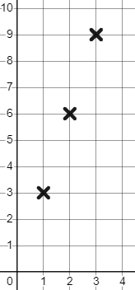

Plotting arithmetic sequences
This visual representation of 3n demonstrates that…
The sequence is linear.
The coordinates align.
The sequence increases by 3 each time.
The sequence starts at the origin (0,0)
The is no zero term number.
Zero is not a term value in our sequence.
Term value
+3
+1
Term number

Slide 11
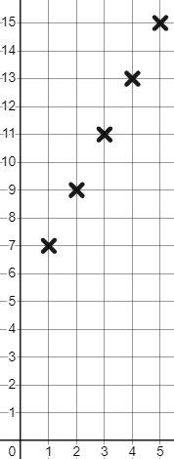


Plotting arithmetic sequences
This is the sequence represented graphically.
Term value
Term number (n) | 1 | 2 | 3 | 4 | 5
Term value (T) | 7 | 9 | 11 | 13 | 15
What will be different if we plot the sequence ?
The sequence decreases. We are going to end up with negative term values.
Term number

Slide 12
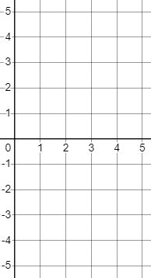
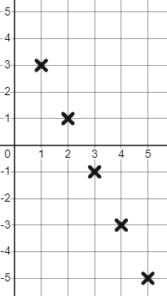
Plotting arithmetic sequences
Plot the sequence graphically.
Term number (n) | 1 | 2 | 3 | 4 | 5
Term value (T)
Term value
Term number (n) | 1 | 2 | 3 | 4 | 5
Term value (T) | 3 | 1 | −1 | −3 | −5
Term number

Slide 13
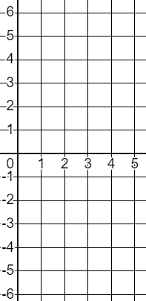
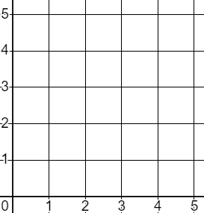
Plotting arithmetic sequences
When we plot sequences we’ll only need the first quadrant.
Term numbers are always positive.
We need the fourth quadrant too because term values can be negative.

Slide 14
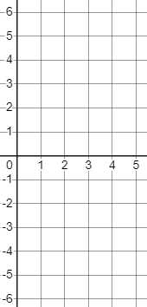


Plotting arithmetic sequences
1) Find and plot the first five terms of these arithmetic sequences.
Term value
a)
Term number (n) | 1 | 2 | 3 | 4 | 5
Term value (T)
Term number (n) | 1 | 2 | 3 | 4 | 5
Term value (T)
b)
Term number (n) | 1 | 2 | 3 | 4 | 5
Term value (T)
Term number (n) | 1 | 2 | 3 | 4 | 5
Term value (T)
Term number

Slide 15
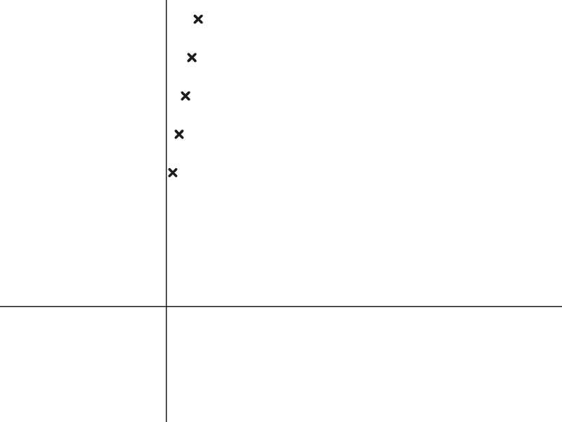
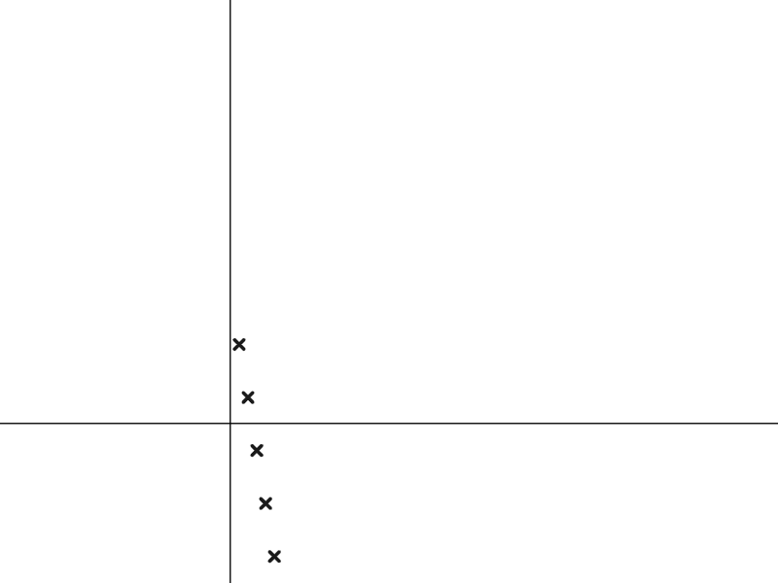
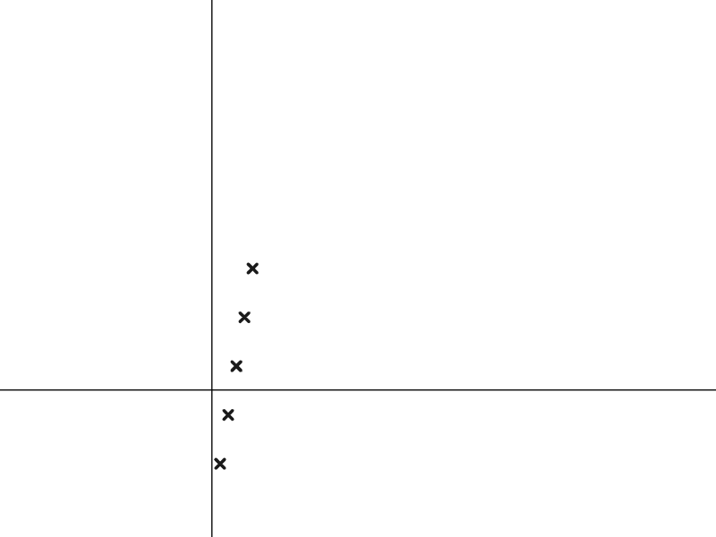



Plotting arithmetic sequences
2) Match the sequences to their graph.

Slide 16
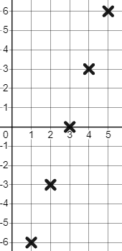
Plotting arithmetic sequences
1) Find and plot the first five terms of these arithmetic sequences.
Term value
a)
Term number (n) | 1 | 2 | 3 | 4 | 5
Term value (T) | -6 | -3 | 0 | 3 | 6
Term number (n) | 1 | 2 | 3 | 4 | 5
Term value (T)
Term number (n) | 1 | 2 | 3 | 4 | 5
Term value (T) | −6 | −3 | 0 | 3 | 6
Term number

Slide 17
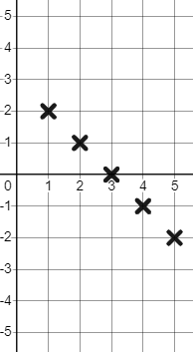
Plotting arithmetic sequences
1) Find and plot the first five terms of these arithmetic sequences.
Term value
b)
Term number (n) | 1 | 2 | 3 | 4 | 5
Term value (T) | 2 | 1 | 0 | -1 | -2
Term number (n) | 1 | 2 | 3 | 4 | 5
Term value (T)
Term number (n) | 1 | 2 | 3 | 4 | 5
Term value (T) | 2 | 1 | 0 | −1 | −2
Term number

Slide 18
Plotting arithmetic sequences
2) Match the sequences to their graph.
Decreasing sequence.
Increasing sequence with all positive term values.
Increasing sequence with some negative term values.

Slide 19
Representing sequences graphically
Plotting arithmetic sequences
Features of sequences represented graphically

Slide 20
Features of sequences represented graphically
What is the same and what is different about these two sequences?
+2
+2
+2
+2
+3
+3
+3
+3
+3
+2
+2
+2
+2
Same:
Different:
Both are arithmetic sequences with a common difference of +2
The terms of 2n + 3 are a translation of +3 from 2n

Slide 21
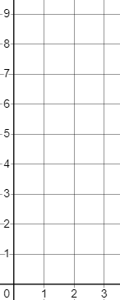

Features of sequences represented graphically
Let’s explore how we will see their similarity and difference when we plot them graphically.
✖
Term value
✖
Term number (n) | 1 | 2 | 3
Term value (T) | 2 | 4 | 6
✖
✖
✖
✖
Term number (n) | 1 | 2 | 3
Term value (T) | 5 | 7 | 9
Term number

Slide 22
Features of sequences represented graphically
Let’s explore how we will see their similarity and difference when we plot them graphically.
✖
+2
+3
Term value
✖
✖
✖
+2
✖
+3
Same:
✖
+2
Both are arithmetic sequences with a common difference of +2
✖
+3
+2
Different:
✖
The terms of 2n + 3 are a translation of +3 from 2n
Term number

Slide 23


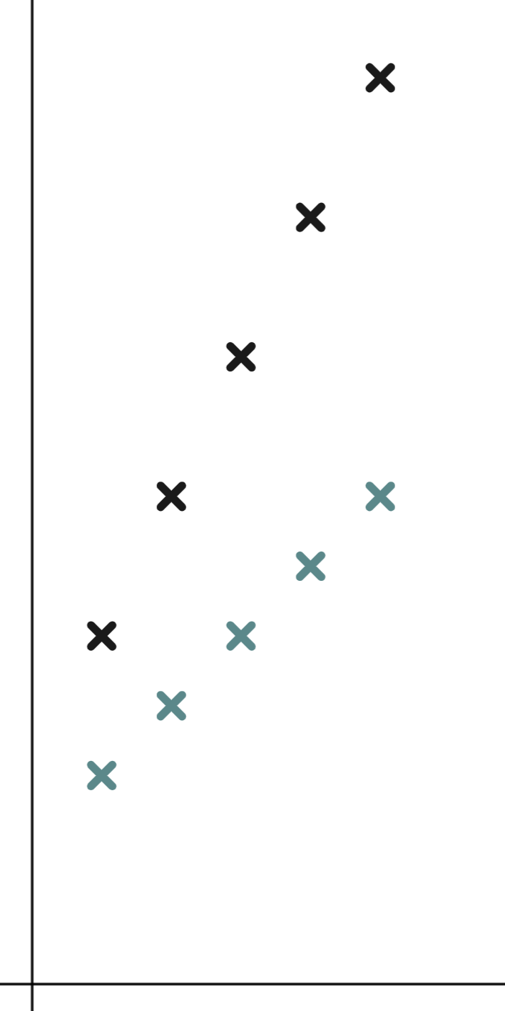
Features of sequences represented graphically
Could these two sequences be and ?
Term value
One is above the other and 8 is above 3.
The sequences do not have the same steps of increase so they can’t both be 5n sequences.
Term number

Slide 24




Features of sequences represented graphically
Oak students are discussing two sequences.
Term number (n) | 1 | 2 | 3 | 4 | 5
Term value (T)
Term number (n) | 1 | 2 | 3 | 4 | 5
Term value (T) | 4 | 8 | 12 | 16 | 20
Term number (n) | 1 | 2 | 3 | 4 | 5
Term value (T)
Term number (n) | 1 | 2 | 3 | 4 | 5
Term value (T) | 5 | 9 | 13 | 17 | 21
The 5th term of is 20 so the 10th term must be double that. The 10th term is 40.
The 5th term of is 21 so the 10th term must be double that. The 10th term is 42.
Lucas
Do you agree with them?
Sofia

Slide 25
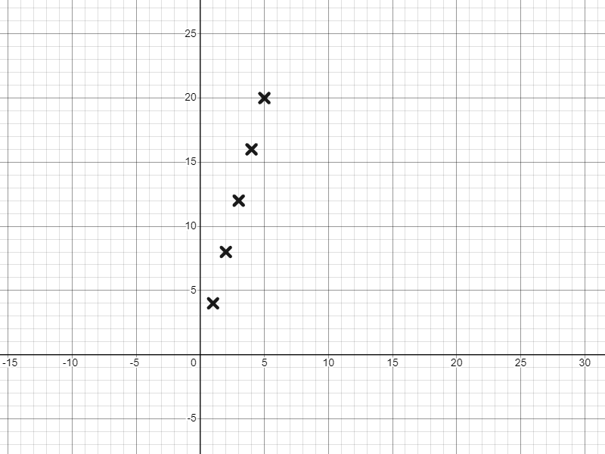

Features of sequences represented graphically
Graphical representations help us to see the structure of sequences.
Term value
Term number (n) | 1 | 2 | 3 | 4 | 5
Term value (T) | 4 | 8 | 12 | 16 | 20
Term number (n) | 1 | 2 | 3 | 4 | 5
Term value (T) | 4 | 8 | 12 | 16 | 20
The 5th term of is 20 so the 10th term must be double that. The 10th term is 40.
Lucas
Term number

Slide 26
Features of sequences represented graphically
The 5th term of is 20 so the 10th term must be double that. The 10th term is 40.
Lucas
Exactly double the height.
The fifth term of
The tenth term of
Lucas is right.
The 10th term is 40.
It’s double the 5th term.

Slide 27
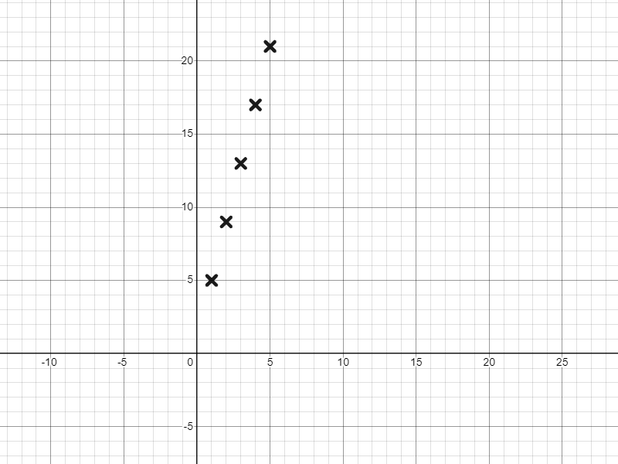

Features of sequences represented graphically
So how will look different in its structure?
Term number (n) | 1 | 2 | 3 | 4 | 5
Term value (T) | 5 | 9 | 13 | 17 | 21
Term value
Term number (n) | 1 | 2 | 3 | 4 | 5
Term value (T) | 5 | 9 | 13 | 17 | 21
As the sequence progresses what changes?
The number of fours.
The one.
What never changes?
In the expression 4n + 1, 4n is a variable term whereas 1 is a constant.
Term number

Slide 28
Features of sequences represented graphically
The fifth term of
The tenth term of
Not double the height.
The 1 (the constant) did not double.

Slide 29
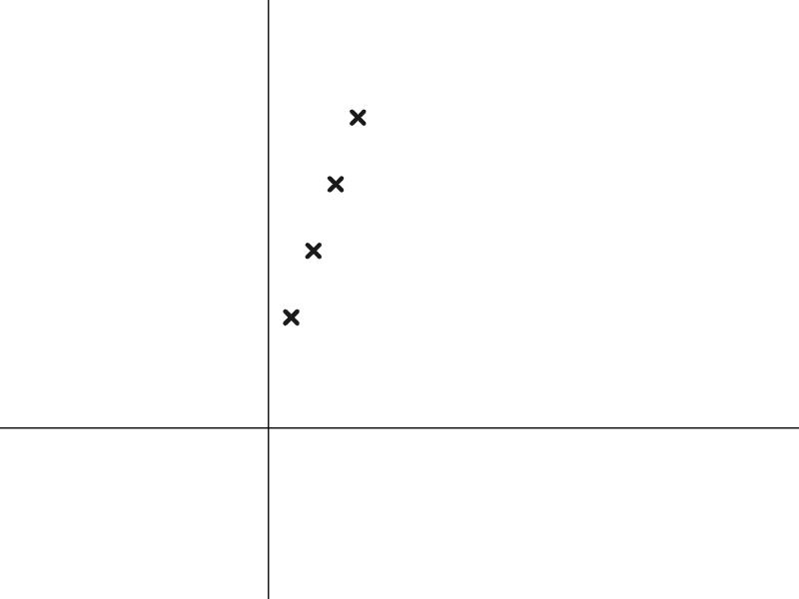


Features of sequences represented graphically
Which arithmetic sequence is represented by this structure?
Term value
There is a constant 2, and a varying number of 3s.
Term number

Slide 30

Features of sequences represented graphically
What is different about the sequence n² by comparison to 2n ?
+2
+2
+2
+2
+3
+5
+7
+9
2n is an arithmetic sequence, it’s linear.
The sequence n² is not. We can call it non-linear.
Does that mean we can’t plot it?

Slide 31
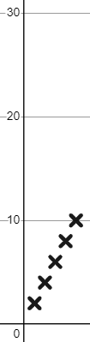
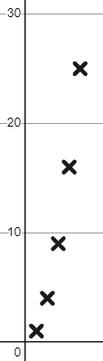
Features of sequences represented graphically
+2
+2
+2
+2
+3
+5
+7
+9
Term value
Term value
How do the two graphical representations look different to one another?
Term number
Term number

Slide 32
Features of sequences represented graphically
+2
+2
+2
+2
+3
+5
+7
+9
Term value
Term value
Arithmetic, Linear sequence.
Constant common difference of +2
Non-linear.
Ever increasing difference between terms ‘steepening’ our graph.
Term number
Term number

Slide 33
Features of sequences represented graphically
The points of every sequence we plot will be in a straight line.
I’ve plotted 3n − 9, 3 − n, 5 + 2n, 5 − 2n and they were all in a straight line so I think all sequences do that.
The points of non-linear sequences such as n² and n³ will not generate a straight line.

Slide 34
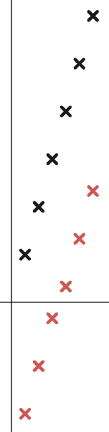
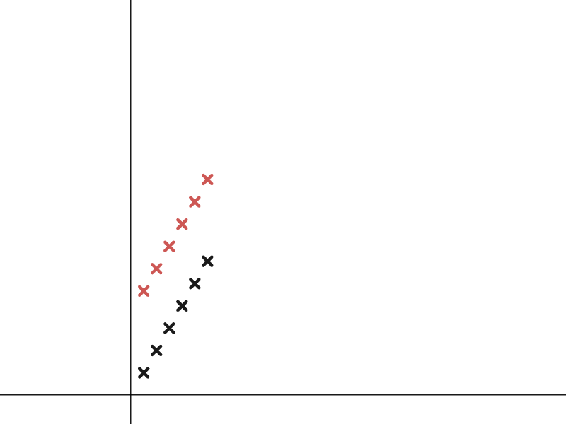


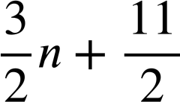

Features of sequences represented graphically
1) a) Match these arithmetic sequences to the correct plotting.
b) Write a few sentences explaining how you identified each sequence.

Slide 35
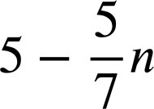

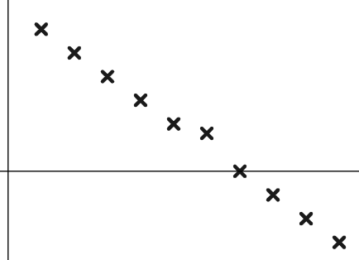
Features of sequences represented graphically
2) Izzy has plotted the sequence
Term value
Which term number is wrong?
Write a sentence to justify your answer.
Term number

Slide 36
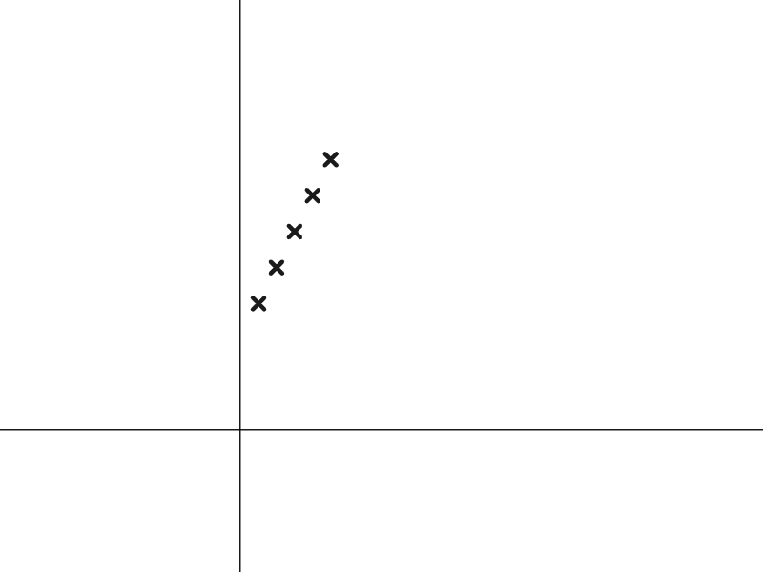
Features of sequences represented graphically
3) a) Sofia has started to draw the structure of the arithmetic sequence 2n + 5
Finish her diagram for her.
Term value
b) Write a sentence explaining why this structure represents the sequence 2n + 5
Term number

Slide 37

Features of sequences represented graphically
4) The 10th term of the arithmetic sequence 3.5n is 35 and the 20th term is 70 so Laura says…
I know the 10th term of the arithmetic sequence 3.5n − 21 is 14 so the 20th term must be double that. It’s 28
Explain to Laura why this does work for the arithmetic sequence 3.5n but it doesn’t for the sequence 3.5n − 21

Slide 38

Features of sequences represented graphically
1) a) Match these arithmetic sequences to the correct plotting.
b)
You might have written:
The sequences 3n and 3n − 10 have the same increases term-to-term, with 3n − 10 being a translation of 3n by 10 in the negative vertical direction.
has the same term-to-term increase as but, is a translation by in the positive vertical direction.

Slide 39
Features of sequences represented graphically
2) Izzy has plotted the sequence
Term value
Which term number is wrong?
The 6th term number is wrong.
Term number
is an arithmetic sequence. The points should align and the 6th one is not in line.

Slide 40
Features of sequences represented graphically
3) a) Sofia has started to draw the structure of the arithmetic sequence 2n + 5
Finish her diagram for her.
Term value
b) Write a sentence explaining why this structure represents the sequence 2n + 5
You might have written, the 5 remains constant whereas 2n is a variable, varying the number of 2’s.
Term number

Slide 41
Features of sequences represented graphically
4) The 10th term of the arithmetic sequence 3.5n is 35 and the 20th term is 70 so Laura says…
I know the 10th term of the arithmetic sequence 3.5n − 21 is 14 so the 20th term must be double that. It’s 28
Explain to Laura why this does work for the arithmetic sequence 3.5n but it doesn’t for the sequence 3.5n − 21
You might have said, the sequence 3.5n has no constant so it is just twice as many variables, whereas 3.5n − 21 contains a constant and that constant will not double.

Slide 42
Representing sequences graphically
We can plot sequences graphically by plotting as coordinates their term number and term value.
Multiple representations can allow us to see patterns and structure.

Slide 43

© Oak National Academy 2023.
Produced in partnership with Mathematics in Education and Industry.
Licensed on the Open Government Licence v3.0, except where otherwise stated. See Oak terms and conditions.

